Slide 1
Communicating Data Clearly and Effectively in the Classroom
Katie Metz, MBA
Kelley School of Business, Indiana University Bloomington

Slide 2
Bill Gates Releases Mosquitoes

Slide 3
Agenda
Data Communication Overview
Tools for Excellent Data Communication
Examples of Excellent Data Communication
Communicating Data Without a Visual Aid
Question and Answer

Slide 4
Data Communication Overview
Keep it SIMPLE
Focus on AUDIENCE
Goal → turn information into knowledge
Notes:
Brian Shea story – depends on your superior

Slide 5
“Speakers mistakenly think that they can get far more information across than is actually possible in a presentation.”
--Max Atkinson, 2009 (BBC News)
Notes:
2009 article on BBC News, “The Problem with Power Point” – he had some good points.
He goes on to say … PowerPoint makes it so easy to put detailed written and numerical information on slides that it leads presenters into the mistaken belief that all the detail will be successfully transmitted to the audience
SAVE ROOM FOR Q&A – just put the most important “stuff” up front, bold words, numbers, definers, buckets … put the bulky stuff in an appendix

Slide 6
The Most Important Question …
Who are your students?
In-residence or commuting?
Demographics – gender, age, hometown
Extra-classroom obligations?
Full-time or part-time?
Classroom dynamic (e.g., talkative)

Slide 7
Other Communication Factors
How much do your students understand about the course topic / lecture?
  What level is the course?
  How long has it been, if ever, since they were last exposed to this topic?
Where is your presentation?
  Time of day? Day of the week?
  Classroom setup and capabilities?
Notes:
Anecdotes from my own experience – A325 (if they had A202 recently, they were more likely to do better because they were recently exposed); 8am classes are tougher eggs to crack, as are Thursday evening classes during Little 500. Does your classroom have windows? Tech capabilities? What can you use to your advantage? Do you need to mix it up?

Slide 8
What types of data do you communicate and how?
Create a Wordle

Slide 9
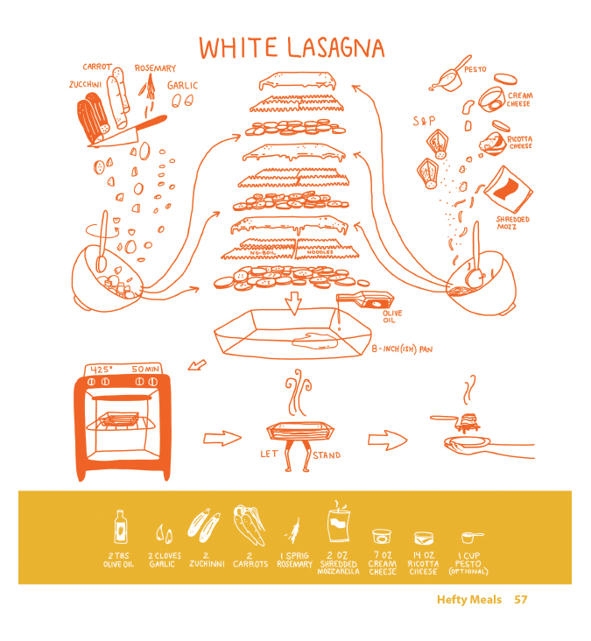
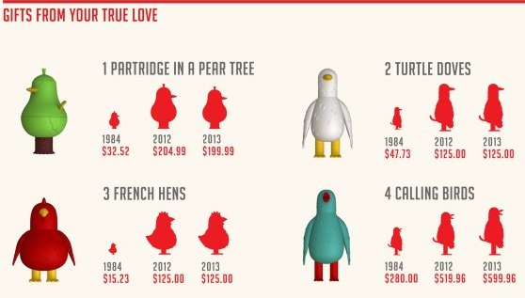
Infographics
http://dailyinfographic.com/getting-ahead-in-business-with-body-language-infographic

Slide 10
Awesome Data Communication Tools
Tagxedo (use www.indiana.edu)
Easelly (Infographics)
Poll Everywhere
Infogram
Padlet (Storyboarding)

Slide 11
According to a 2010 UEFA study detailing spending for European professional soccer, clubs' combined annual loss rose 36 percent from 2009-2010.
Notes:
36 percent stands out, but the audience feels the need to read the entire sentence even if you are explaining it

Slide 12
36%
$520 million
Notes:
Draw attention to bold words and numbers, put into perspective for the audience. 36% equates to $520 million dollars, in spite of increased income of 6.6%

Slide 13
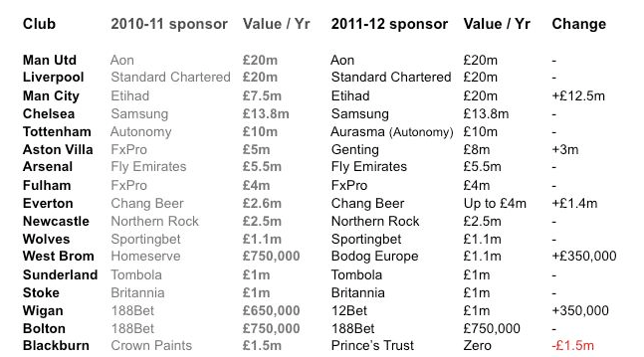
Premier League Sponsorship Deals
Top 8 Teams for 2011-2012
sportingintelligence.com
Notes:
In this case, we only want to know data for the top 8 teams for 2011-2012
What is good about this chart: Lots of information, currency is to the tenth (keeping it simple without oversimplifying), columns easy to ready
What is bad about this chart: information overload. Asking for way more than we need to know.

Slide 14

Notes:
Only showing data we actually need – Top 8 Teams and their revenue
Emphasis on clean lines, cohesive color scheme
Spice it up by adding the logo
Decimals are to the tenth, no gridlines to make the shape cleaner
Simple axis and header titles
Numbers included at the end of the bars to promote clarity
Arrows are a great way to emphasize a point – for example, Arsenal’s low revenue number really surprised me considering how prevalent the team is

Slide 15
Before …
Notes:
This one isn’t scaled correctly, contains a lot of unnecessary gridlines and is bland of color

Slide 16
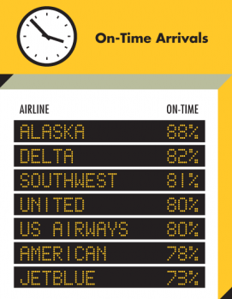
… After
Image courtesy of huffingtonpost.com
Notes:
Same data, creative format, bold, appropriate colors

Slide 17
Before …
Cost
  $50 for paint supplies
  $100 for 2 days of labor
  $20 for transportation
  TOTAL = $170 per job
Revenue
  $300 charged per job
  7 jobs anticipated this summer
  TOTAL = $2100

Slide 18
… After
Cost per job
Supplies | $50
Labor | $100
Transportation | $20
TOTAL | $1,190
Revenue per job | $300
TOTAL | $2,100
Operating Profit | $910

Slide 19
Be Creative!
How might I “think outside of the box” to relate to my students with non-technological visuals?
How might I better convey my message using a visual aid I might not have otherwise tried?
How might I effectively incorporate Prezi?

Slide 20
Communicating Data Clearly and Effectively – Question and Answer
Katie Metz, MBA
kmetz@indiana.edu

